Slide 1

Mangrove Team
Dillon Hicks, Mark Liu, Kathy Qi, Jeremy Smith

Slide 2
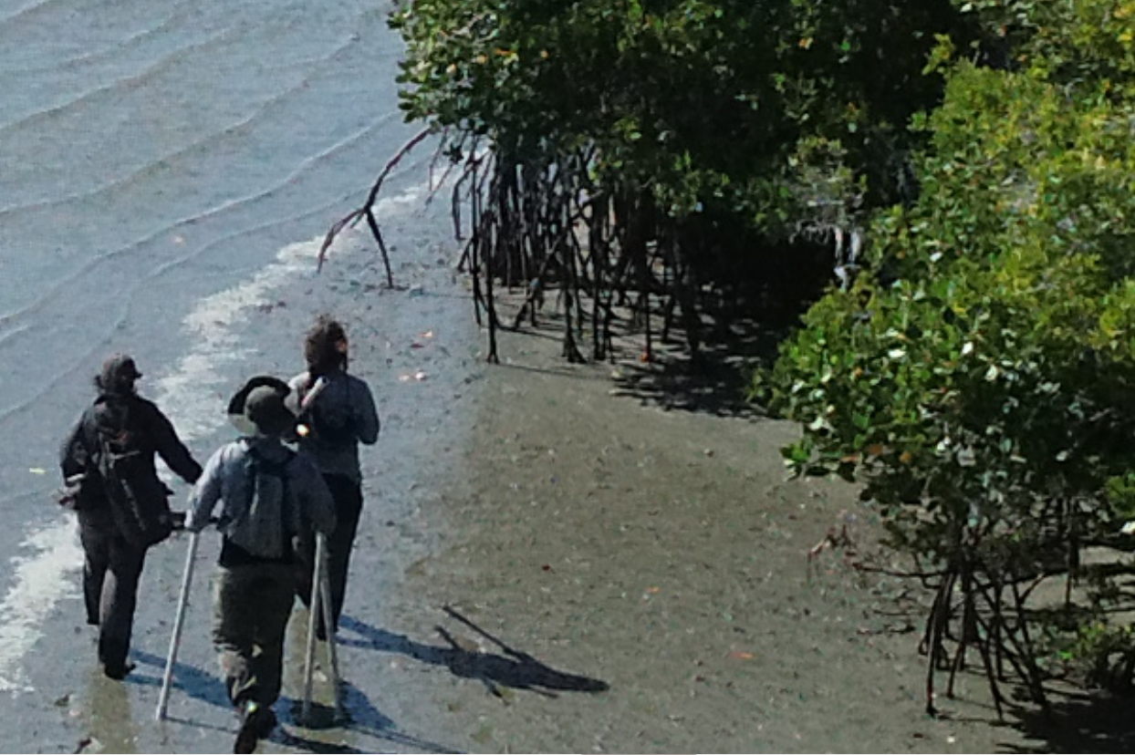
Background
Mangroves are trees and shrubs that have adapted to grow in the intertidal zone along subtropical coastlines. Over 80 species of mangroves span the globe.
Thay have significant impacts on environmental health:
Carbon sequestration
Reduction in coastal erosion
Shelter for diverse organisms
Soil enrichment

Slide 3
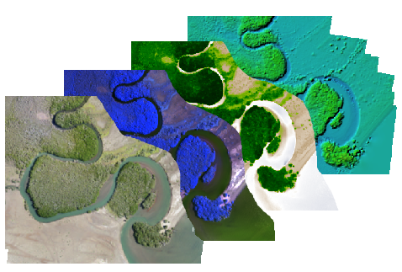
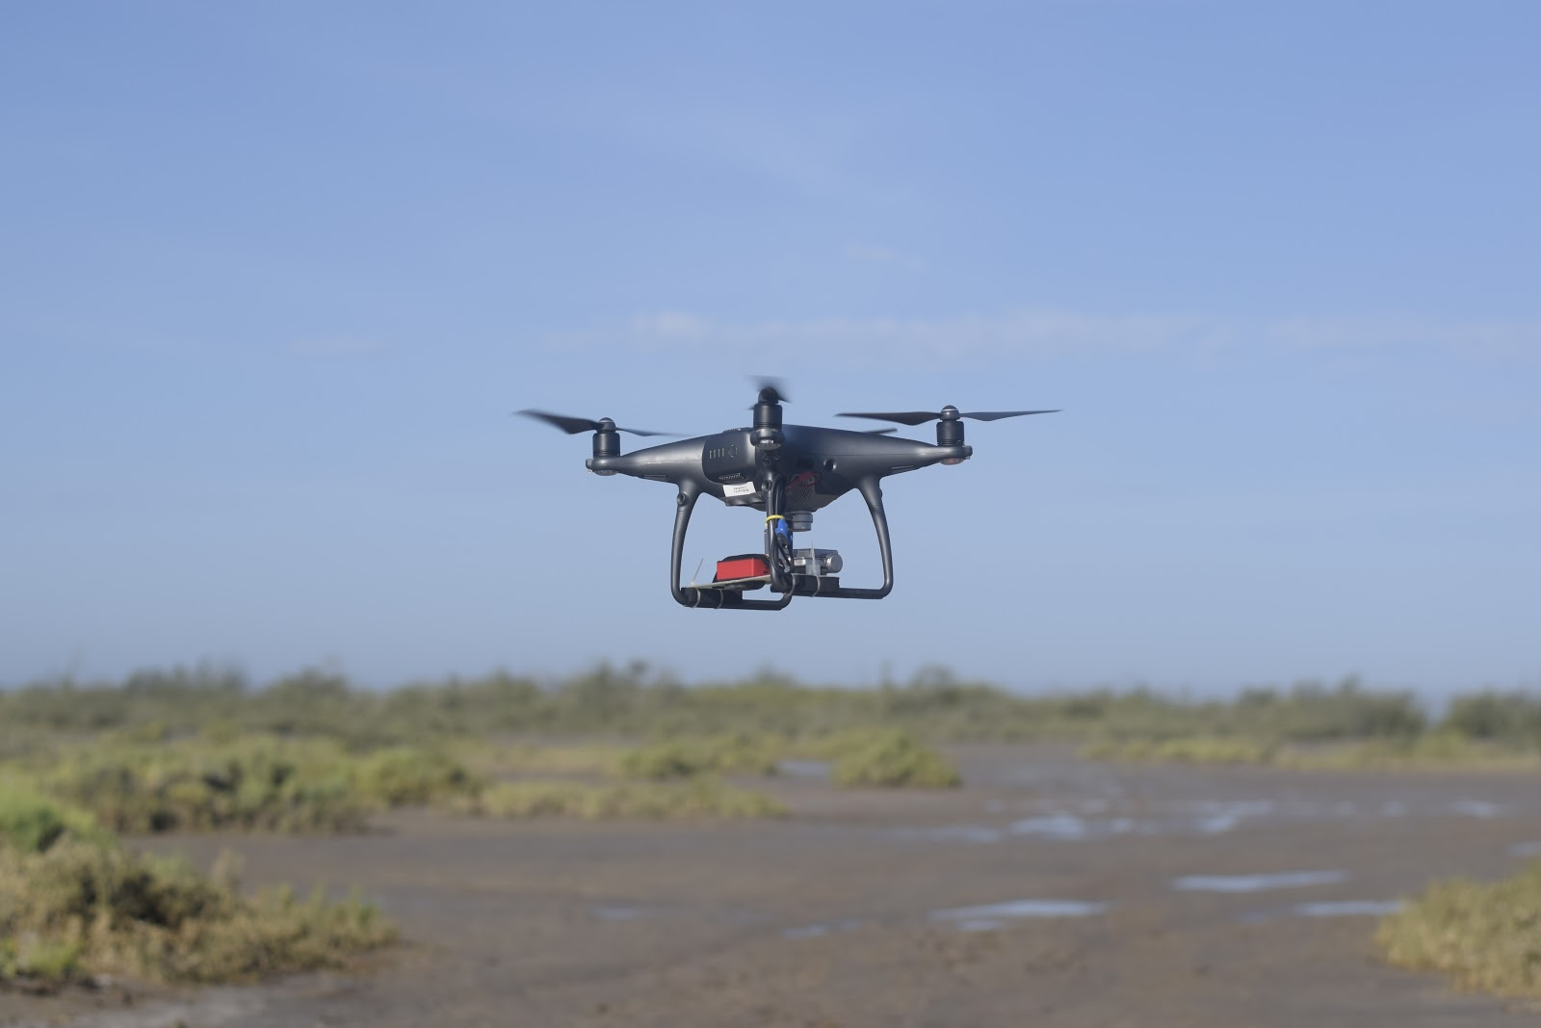
Dwarf Mangrove Species Classification
Our team is creating a scalable procedure for using drone imagery and machine learning algorithms to classify the extent and species composition of dwarf mangroves.
Notes:
Drones vs satellite resolution
Fly a drone

Slide 4
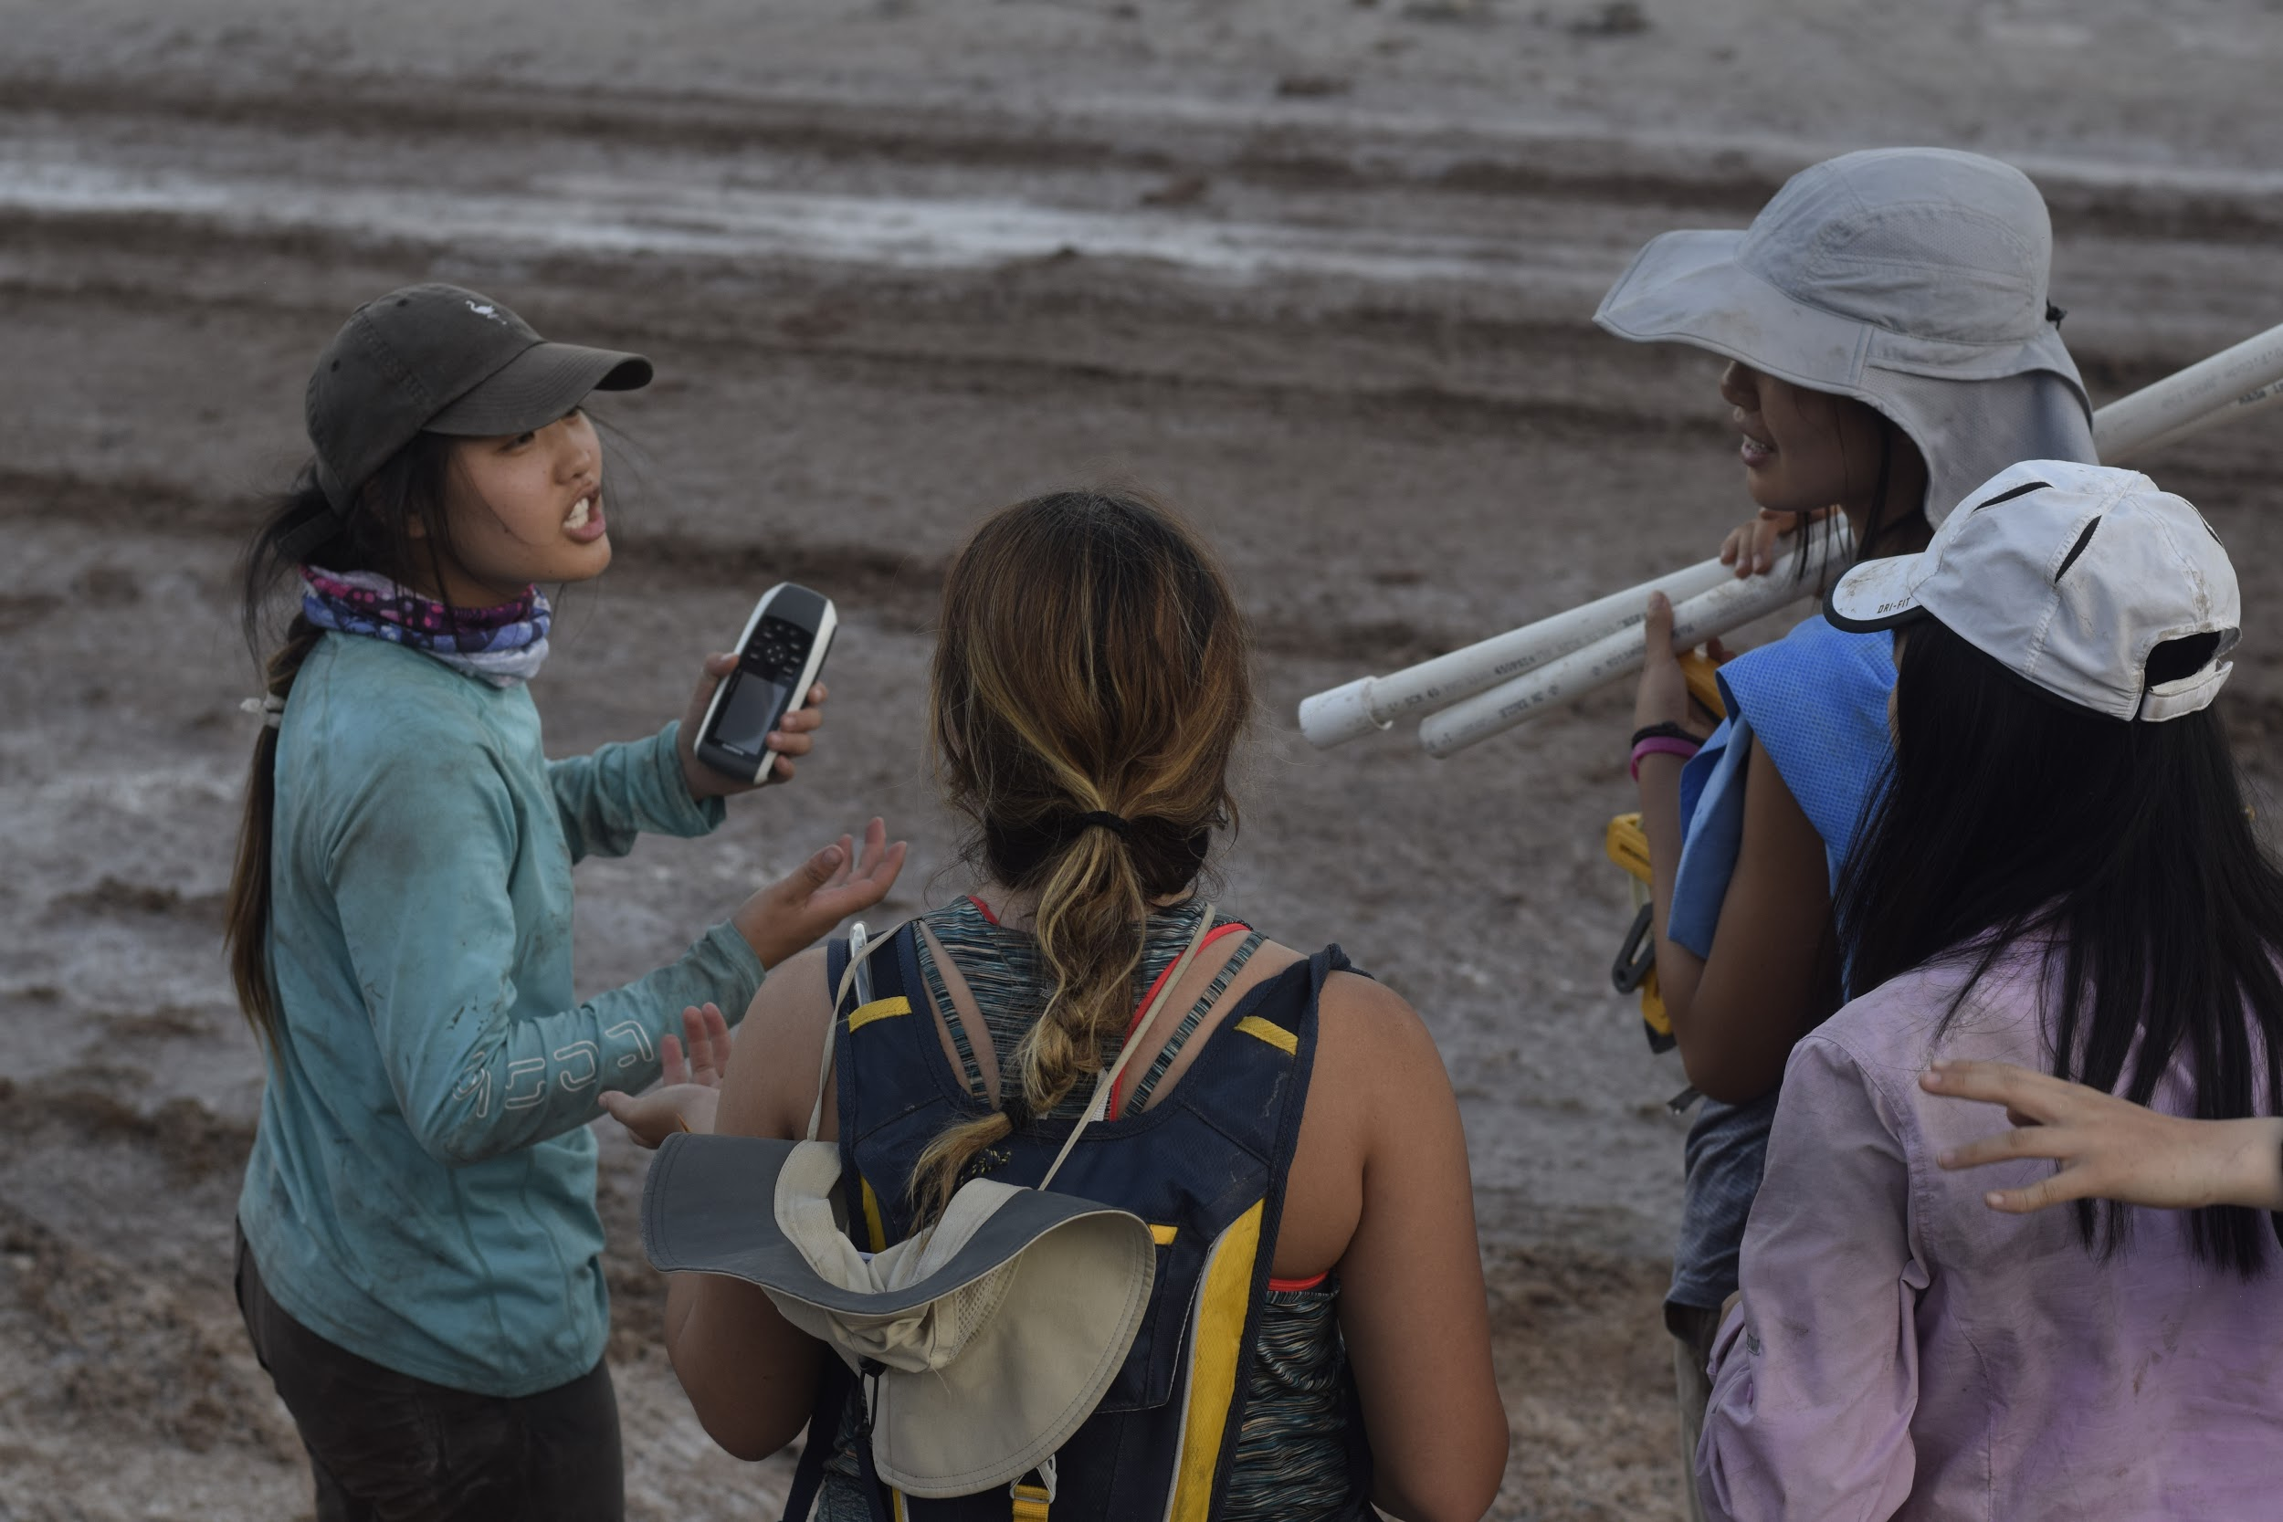
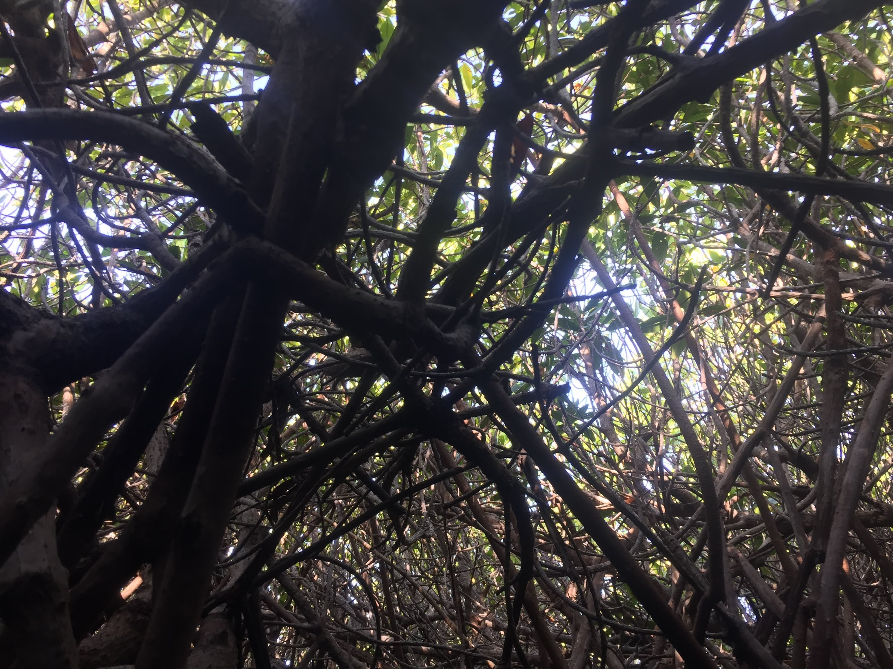
GPS
Essential data for field work
View current location
Mark and track surveyed quadrats
Used for post-processing calculations
Goals:
Robust system to withstand mangrove environment
Very accurate measurements under canopy

Slide 5
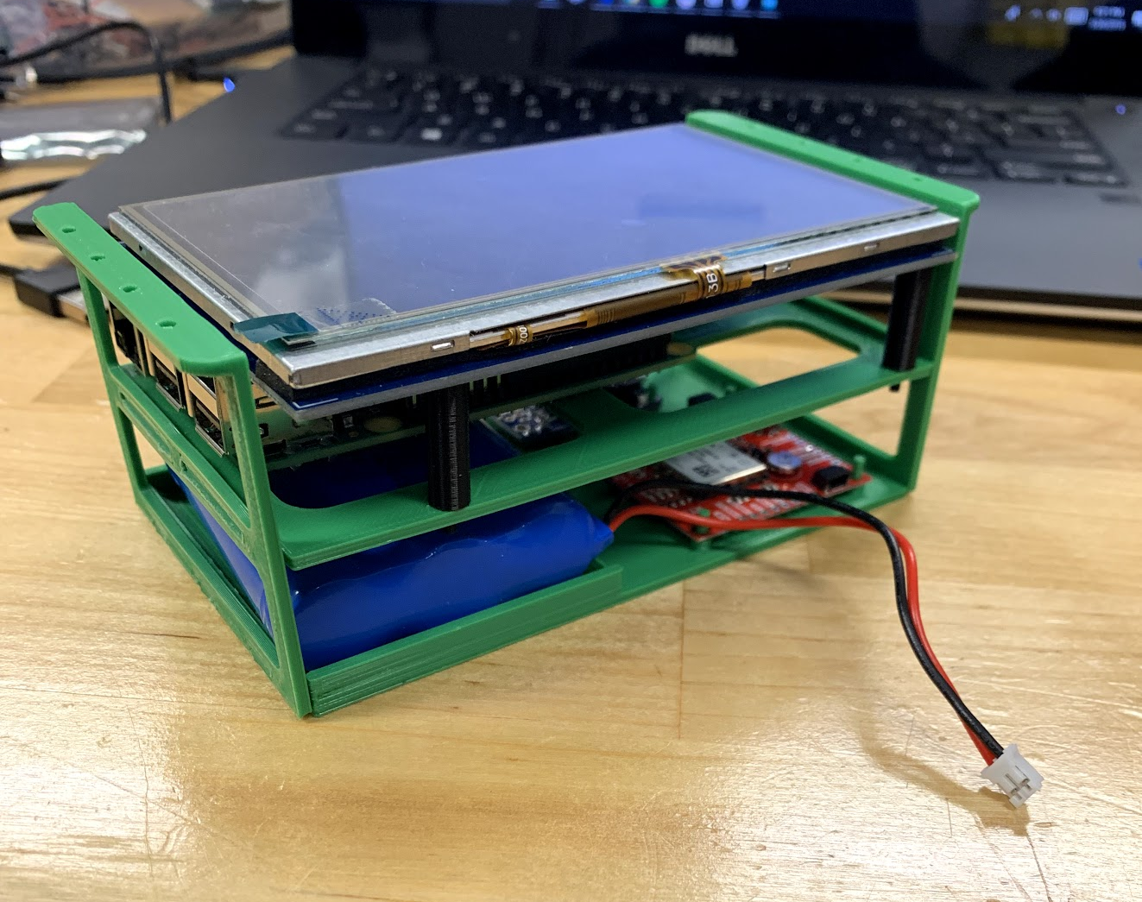
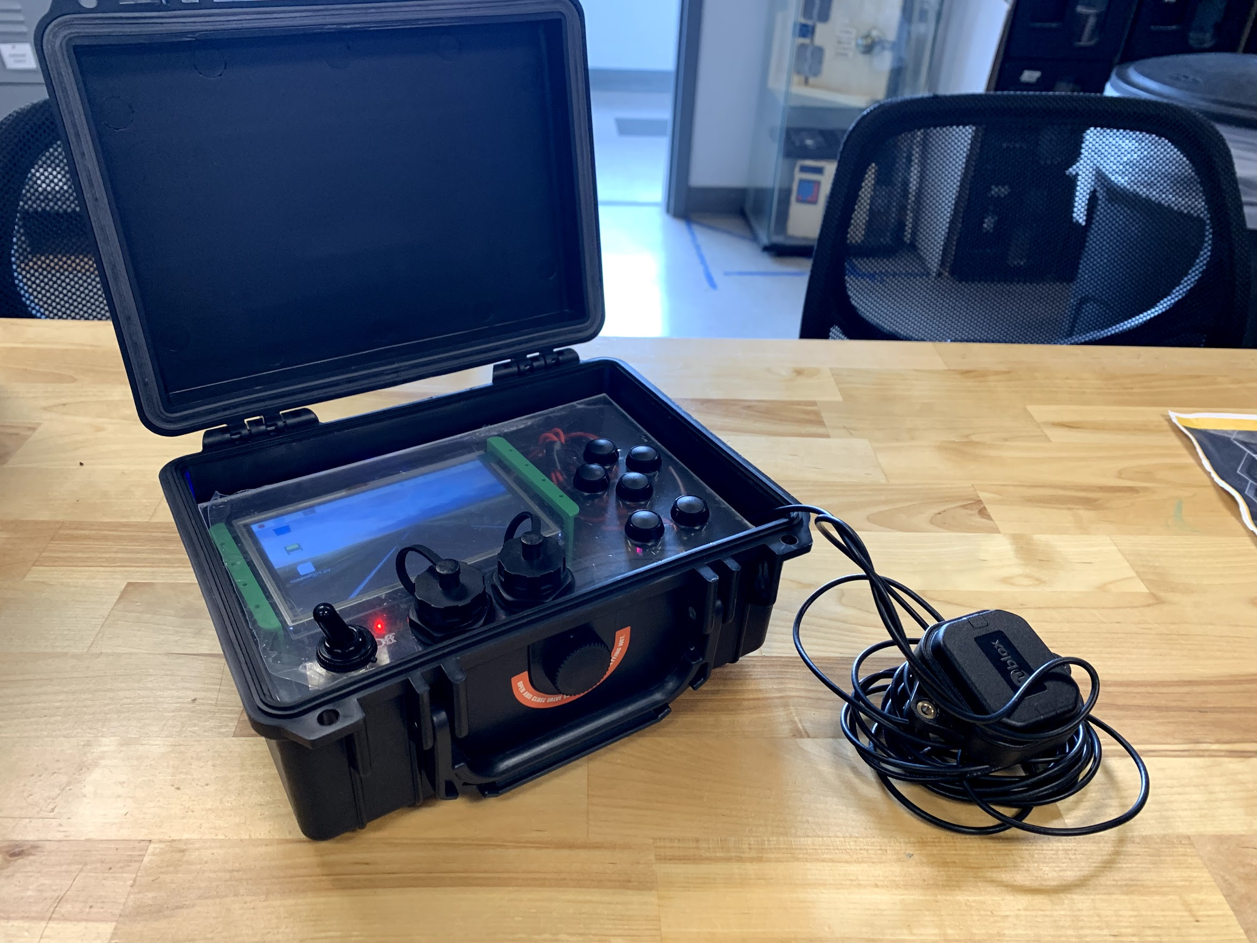
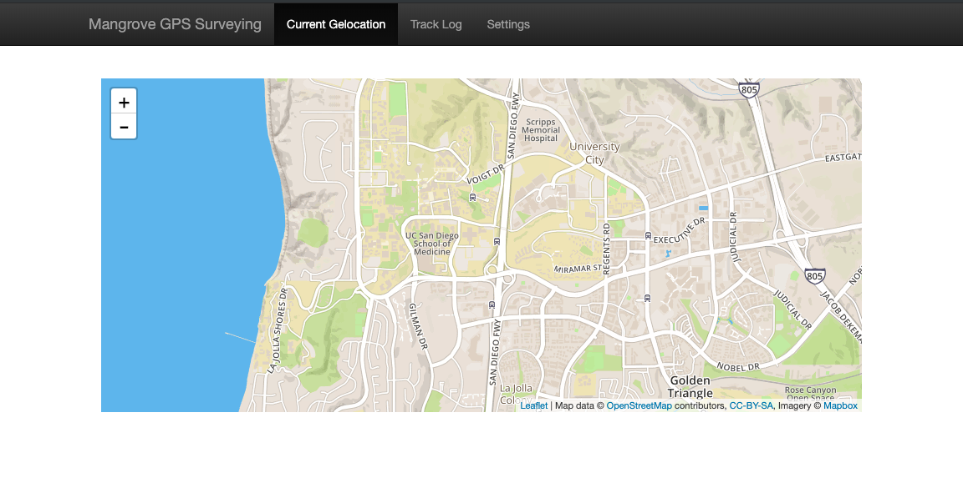
GPS System Overview
Internal Chassis
Assembled Device
Waterproof Case enclosing GPS Electronics and Screen
Accurate GPS Coordinates
Laser Cut frontplate
Raspberry Pi with Screen
Buttons to Control
3D Printed Internal Chassis
6600 mAh battery
RTK-2 Module

Slide 6
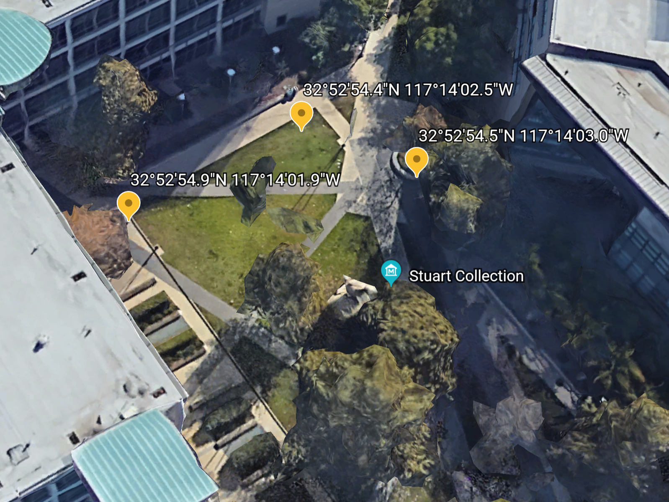
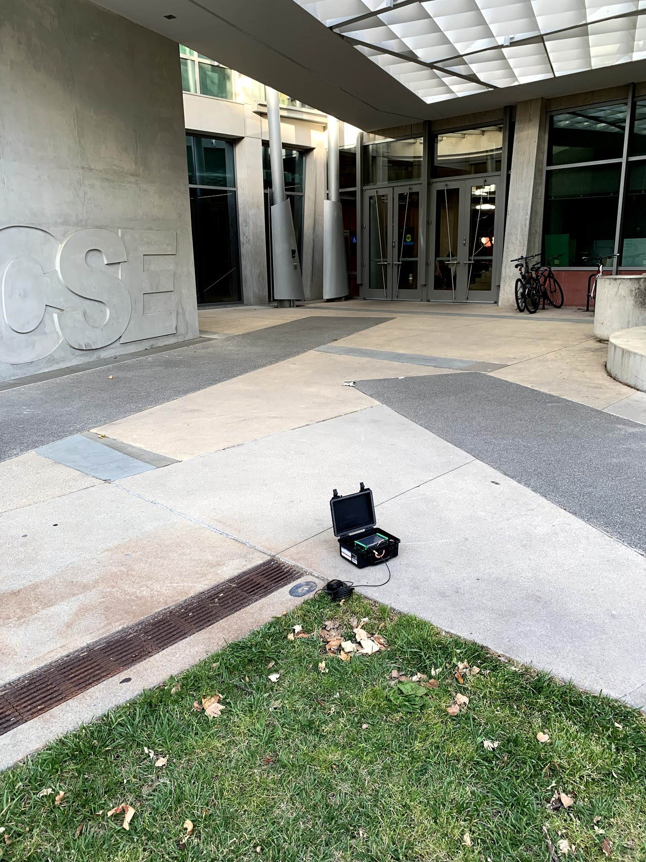
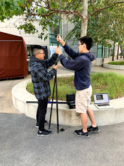
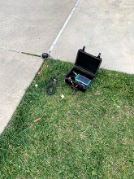
GPS System Testing (Non-RTK)
Non-RTK GPS Points
Testing in CSE courtyard
Successful training
2.69 meter error

Slide 7
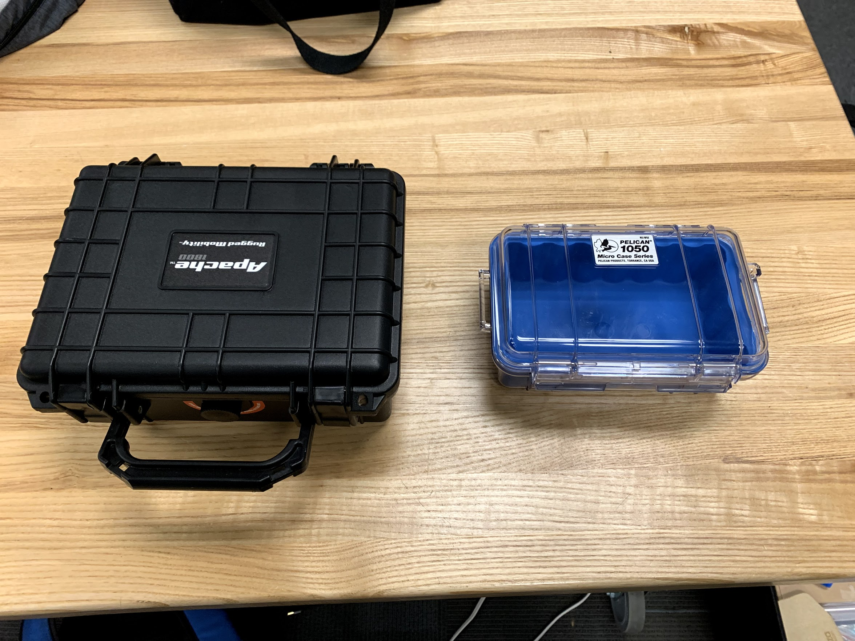
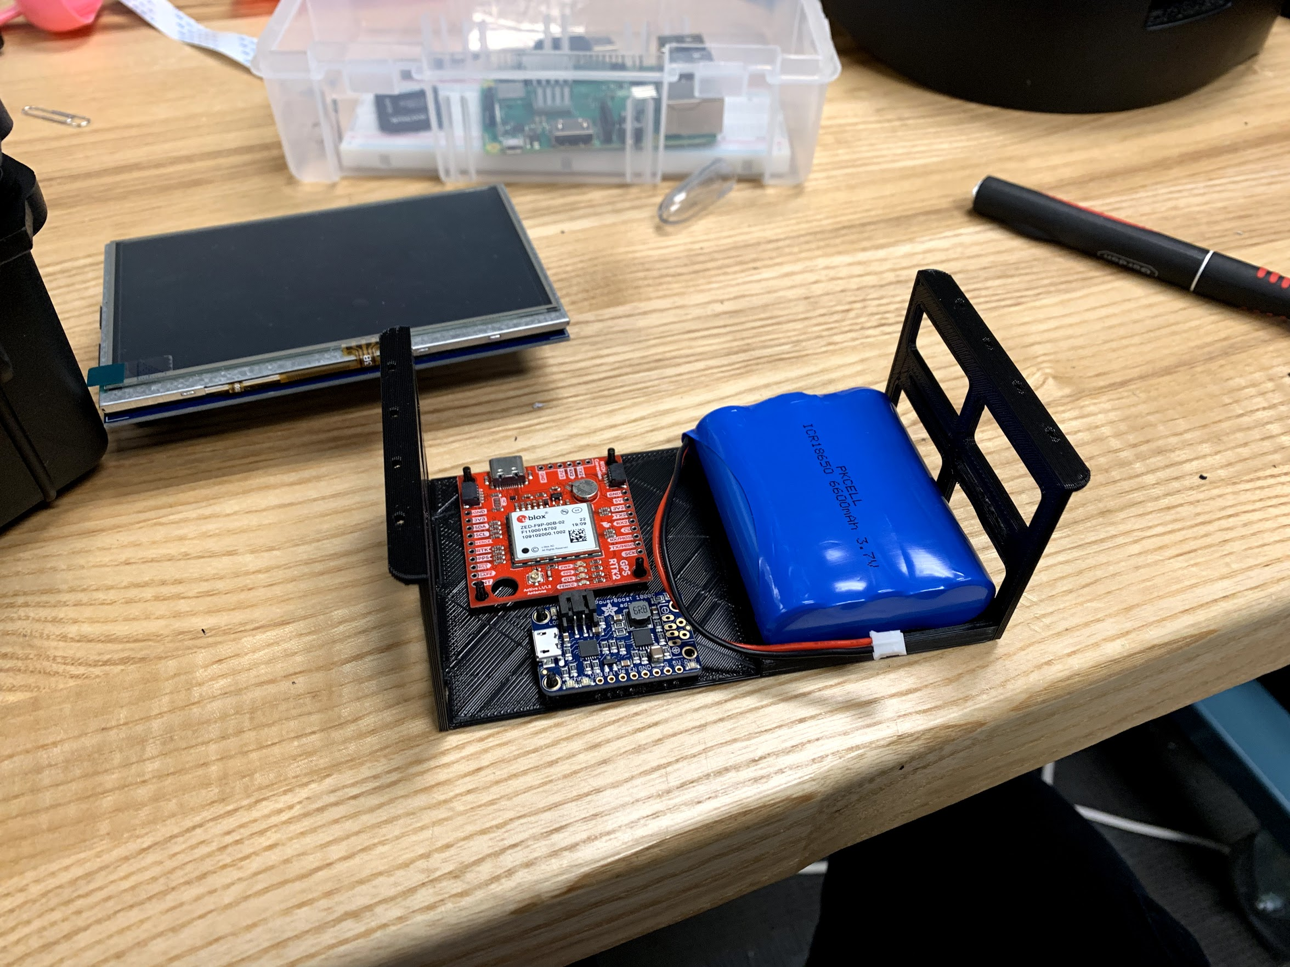
GPS Challenges
New Case
System Design:
Multiple Design Iterations
New Case + Hidden Assumptions
Webpage:
Processing RTK data
Converting maps to be offline
Multiple iterations

Slide 8
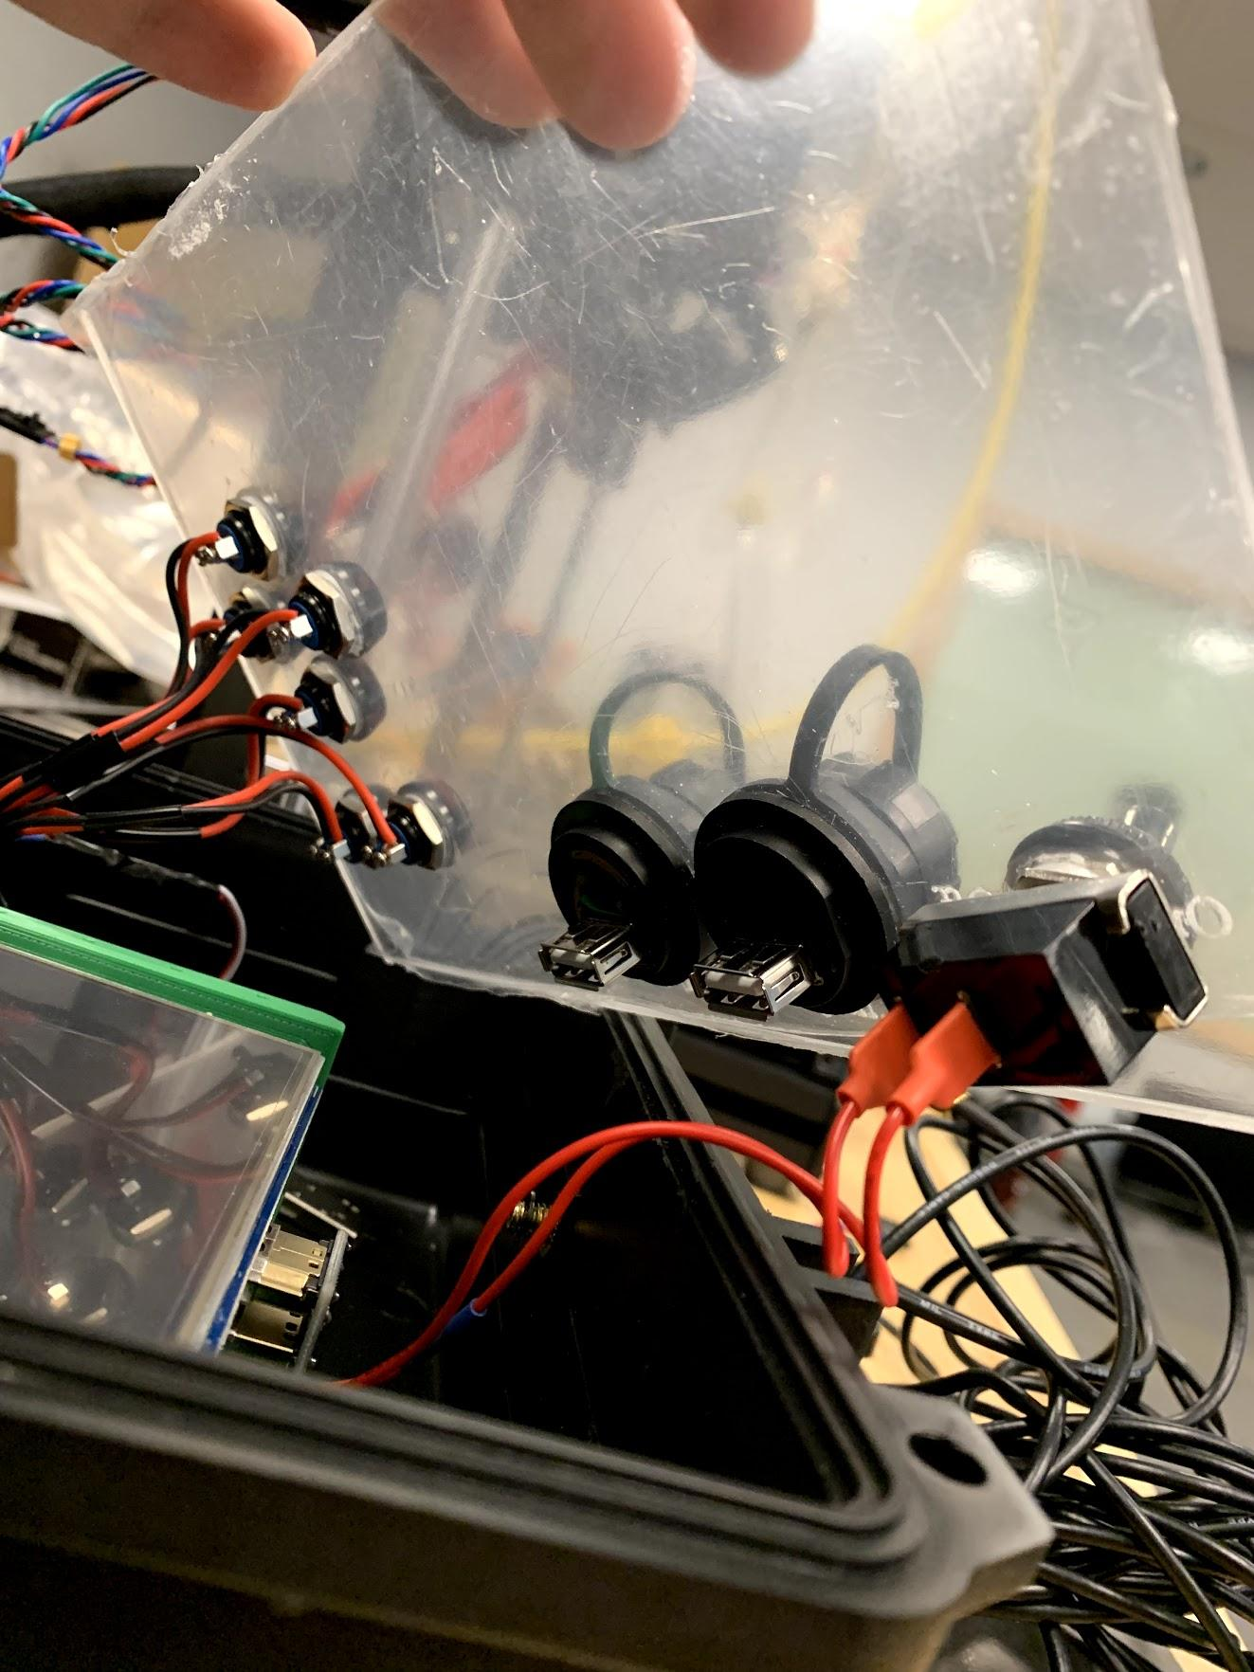
GPS Future Work
Additional field testing
GPS
Final assembly
RTK Integration
USB I/O and charging
Webpage
GPS Coordinates on page
Save coordinates to file
Additional options for tracking

Slide 9
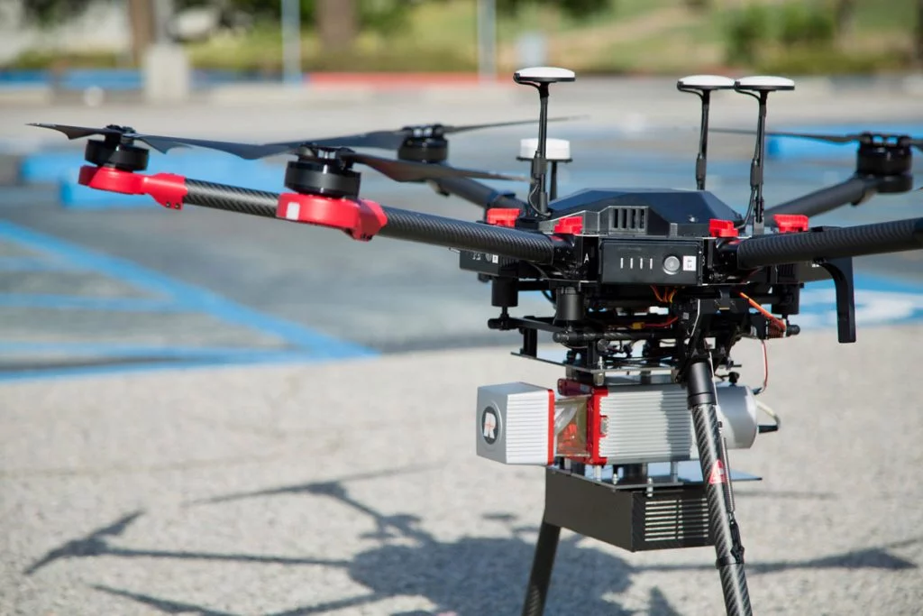
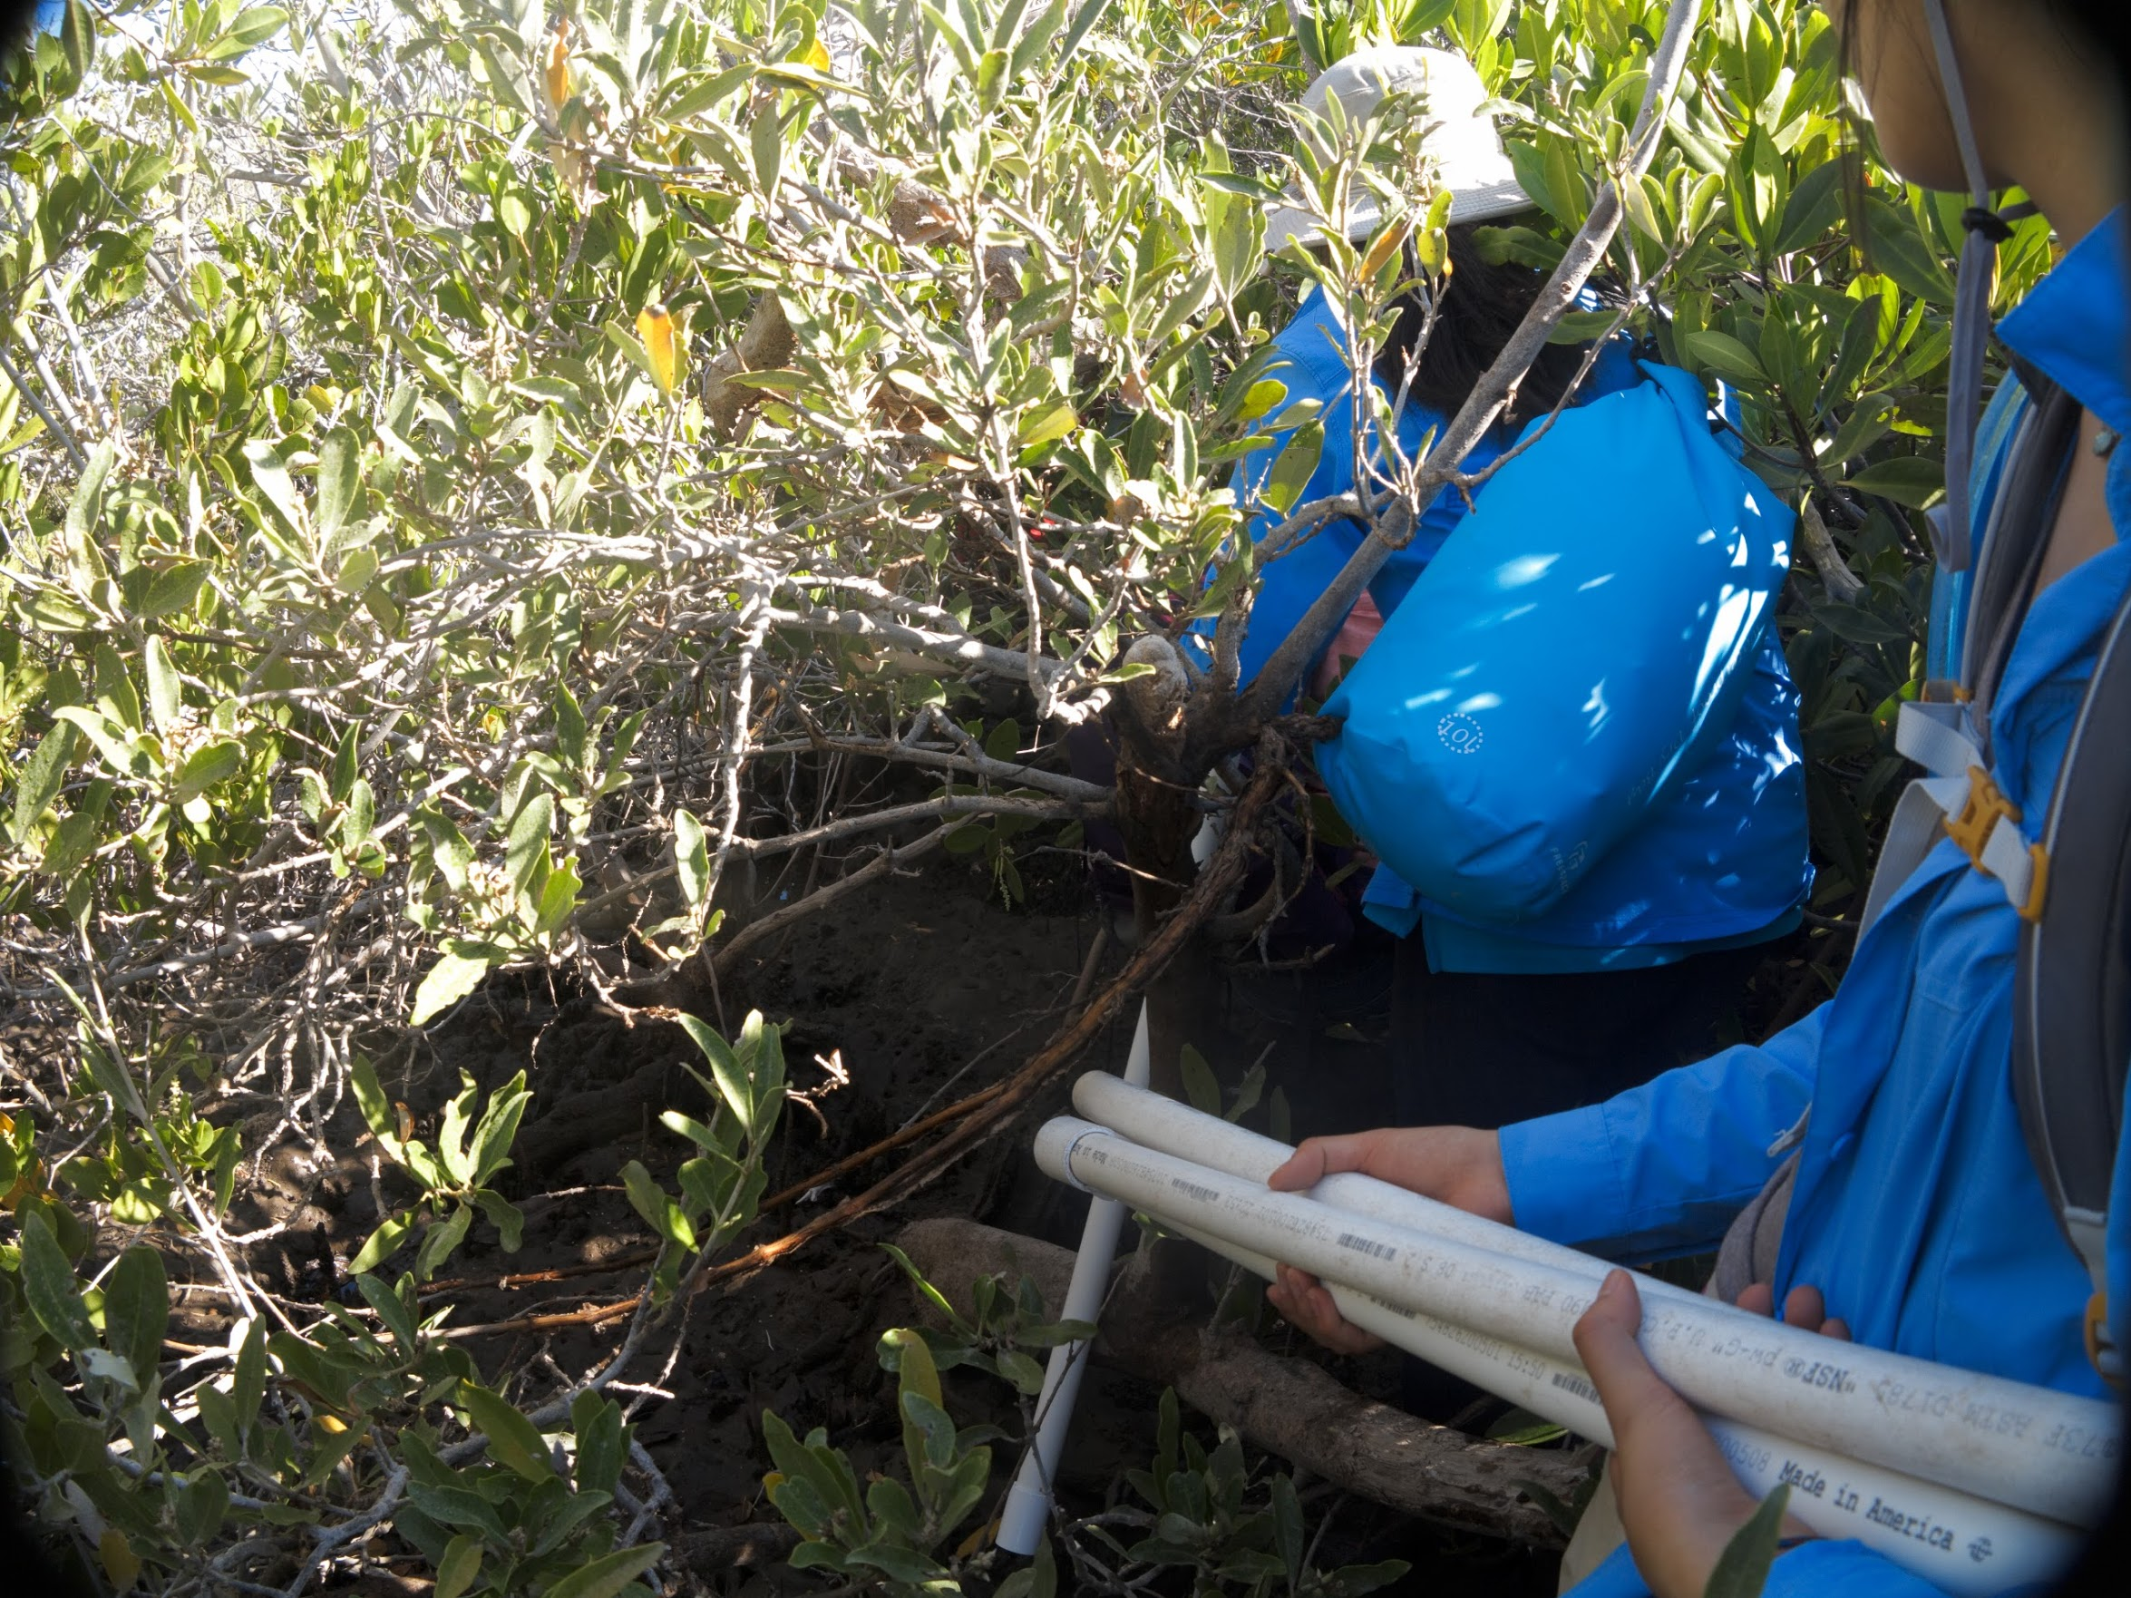
Height Estimation
Vital for biomass calculations.
Existing methods expensive and/or inaccurate.
Goal: Low-cost, low-power, accurate method of calculating mangrove height.
Notes:
Biomass calculations are important because they can give us insight into the amount of carbon stored by mangrove forests. This has direct impacts on the environmental and economic value of the forest, which is important for conservationists to be able to report to local governments.
Talk about why Lidar via drone sucks
Reliable, accurate LiDAR is expensive and may not give us reliable, precise accurate measurements.
Light may reach the bottom, but we don’t know where the actual “ground” is. For example, where would the ground be in a swampy area? To control where we want as the ground, we have to look for an alternative.
Talk about why PVC approach sucks
PVC pipe may not be stacked straight from one end to another. Thus, there may be accuracy errors. It requires a lot of physical effort to climb and stack PVC pipes. Carrying a load of PVC pipes is also a problem.
Our goal is to provide a low-cost, low-power, accurate method of calculating mangrove height.

Slide 10
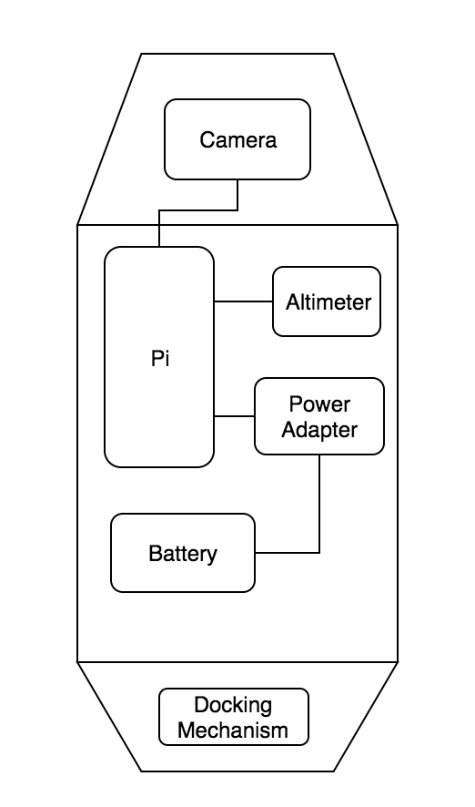
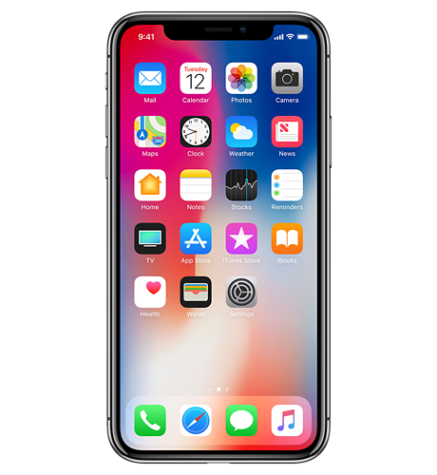
Canopy Height System Overview
Sensor Pod deployable by telescopic pole.
WiFi access point with web server.
Real-time video feed from smartphone browser.

Slide 11
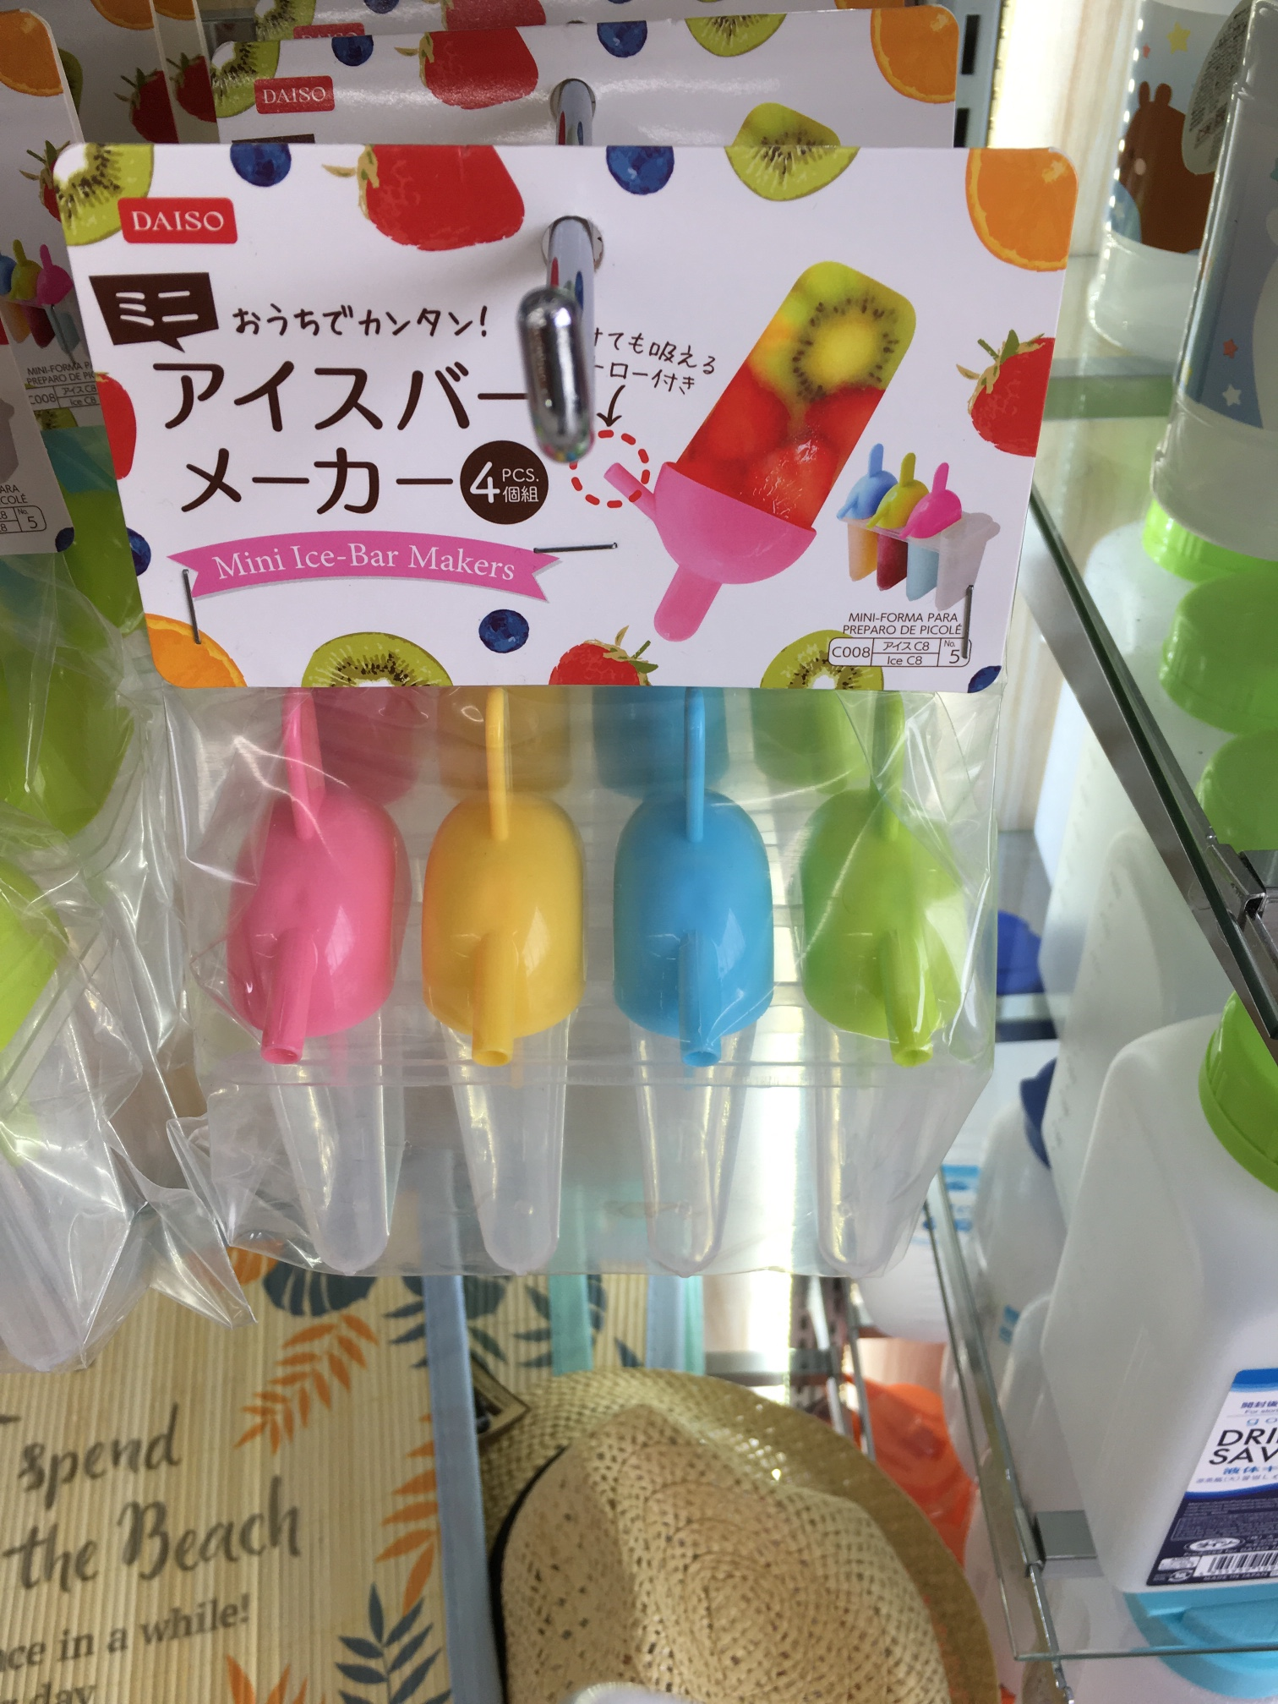
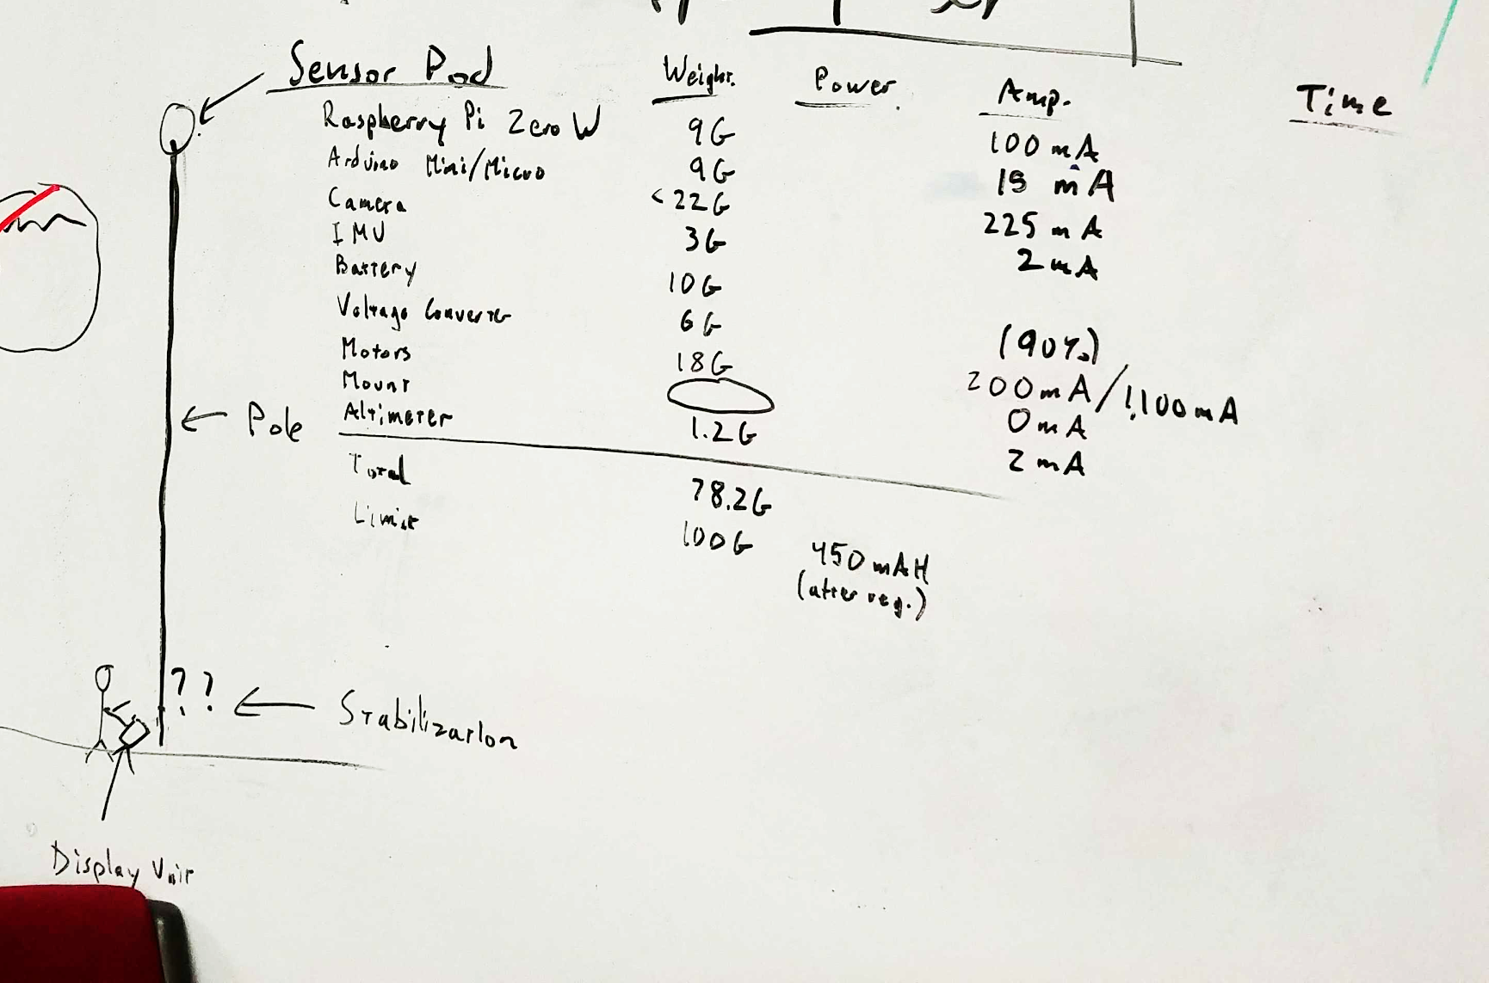
Canopy Height Challenges
Weight of sensor pod
Power requirement of system
Insulation of components
Orientation of camera
Notes:
We had a meeting an calculated the weight of each and every components of the sensor pod. We already tested how much weight the pole is able to handle with a iClicker that weighs approximately 100 grams. Then we calculated the amount of power our system required and the limit of the battery we selected. We also had to consider insulate the sensor pods to protect it. We couldn’t simply wrap it around in a container the altimeter uses pressure and temperature to calculate altitude. We decided on plastic popsicle containers that could be used for our camera to see through. We also used metal mesh that allowed for airflow and serve for protection.

Slide 12
Future Work
Additional field testing
Canopy height documentation
Longer pole with potential stabilization
Permanent sensor pod docking mechanism
Improve the website
Possibly implement a feature to lookup data on the UI
Maybe change flat file -> other database
Test across different browser platforms
Make it easier to reproduce the sensor pod
Solutions for mangroves taller than 10 meters
Possibly attach sensor pod onto a drone instead
Would need to consider limitations of the drone

Slide 13
Questions?
GPS
Waterproof, Robust Case
View maps on device and store positions
Canopy Height Estimation
Telescopic pole
Sensor pod
WiFi access point
Notes:
CONCLUSION

